Slide 1
Differential equation - 2nd order differential equation - 2D differential equations - Taylor series
Nov. 11, 2019
Doug Young Suh

Slide 2
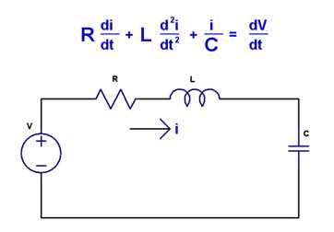
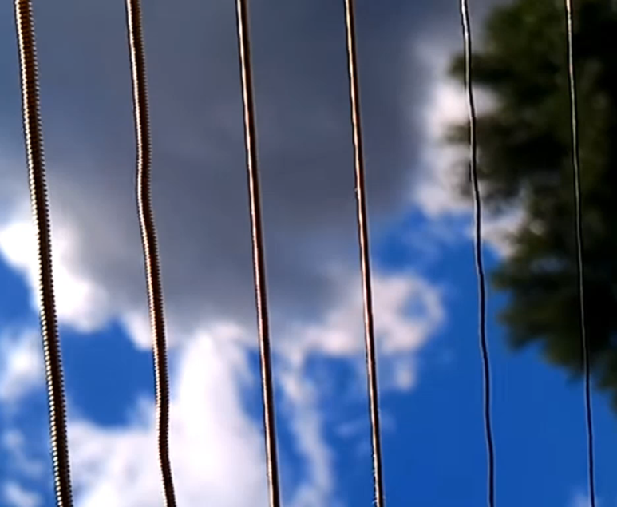
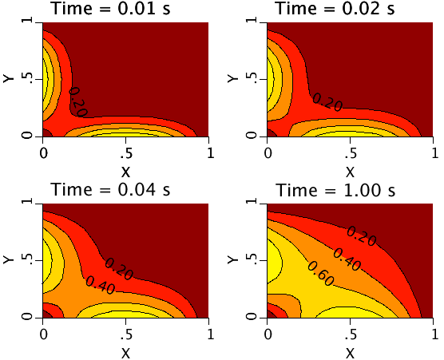
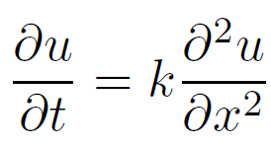
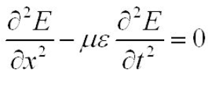
The 2nd order differential equation

Slide 3
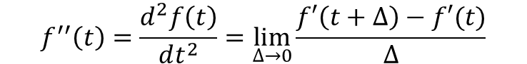
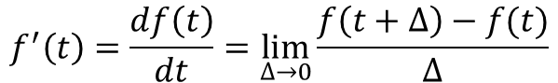
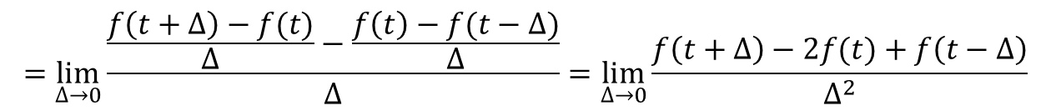
Numerical expression of 2nd order DE
$$f^{′}\left(t\right)=\frac{df\left(t\right)}{dt}=\lim_{∆→0}{\frac{f\left(t+∆\right)−f(t)}{∆}}$$
$$f^{′′}\left(t\right)=\frac{d^{2}f\left(t\right)}{dt^{2}}=\lim_{∆→0}{\frac{f′\left(t+∆\right)−f′(t)}{∆}}$$
$$=\lim_{∆→0}{\frac{\frac{f\left(t+∆\right)−f(t)}{∆}−\frac{f\left(t\right)−f(t−∆)}{∆}}{∆}=\lim_{∆→0}{\frac{f\left(t+∆\right)−2f(t)+f\left(t−∆\right)}{∆^{2}}}}$$

Slide 4
Procedure for numerical solution
Initial condition
Set f_{n} = f(x, t=0) and/or f_{n-1} = f(x, t=-Δ) for all x.
Temporal iteration
Apply boundary condition f_{n+1}(x=x_{min}), f_{n+1}(x=x_{max})
Calculate f_{n+1}(x=x_{min}) for all x.
Set f_{n-1} = f_{n} and f_{n} = f_{n+1} to go forward.
Store results

Slide 5
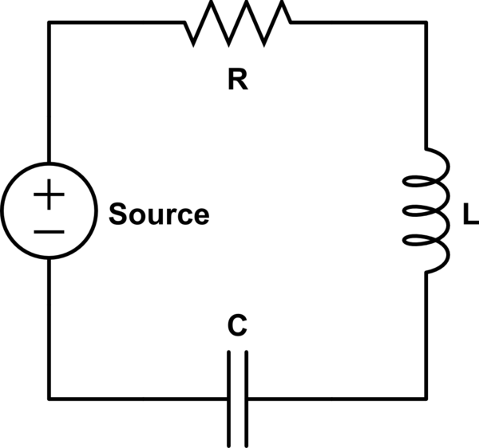
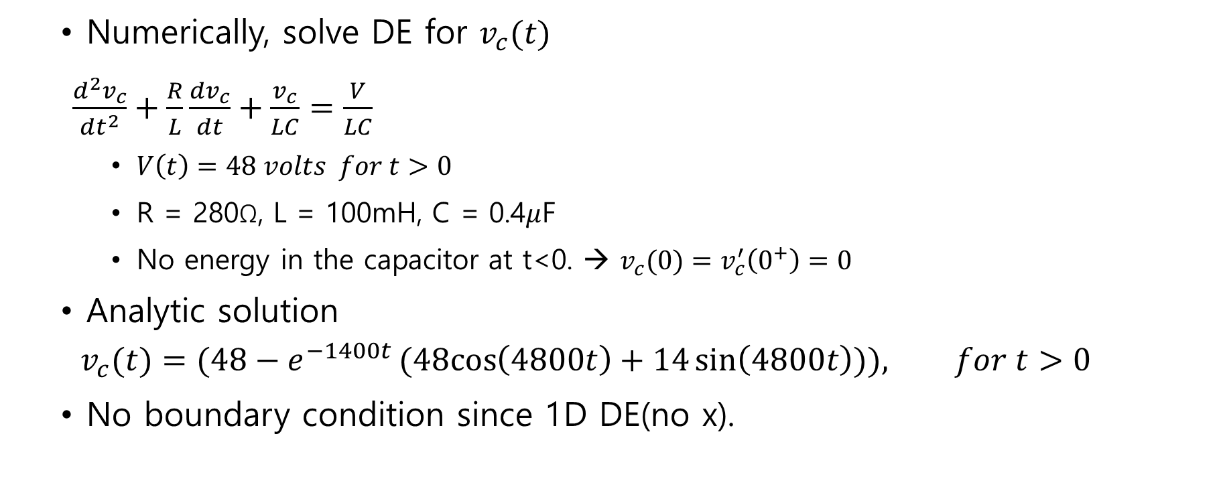

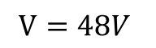
Circuit equation “DEcircuit”
$$t=0$$
Numerically, solve DE for $v_{c}(t)$
$$\frac{d^{2}v_{c}}{{dt}^{2}}+\frac{R}{L}\frac{dv_{c}}{dt}+\frac{v_{c}}{LC}=\frac{V}{LC}$$
$V\left(t\right)=48 volts for t>0$
R = 280Ω, L = 100mH, C = 0.4$μ$F
No energy in the capacitor at t<0. → $v_{c}(0)=v_{c}^{′}\left(0^{+}\right)=0$
Analytic solution
$$v_{c}(t)=(48−e^{−1400t}(48cos\left(4800t\right)+14\sin\left(4800t\right))), for t>0$$
No boundary condition since 1D DE(no x).
$$V=48V$$

Slide 6
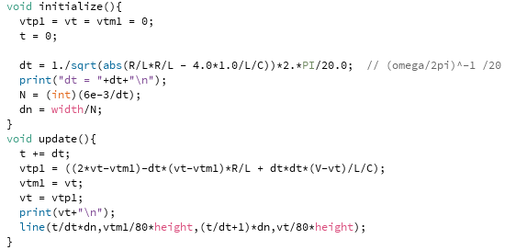
Implementation

Slide 7


Slide 8
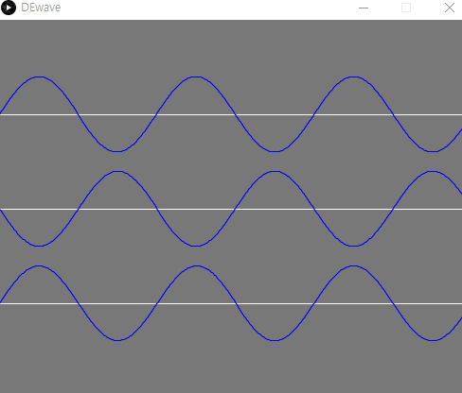
Wave equation

Slide 9
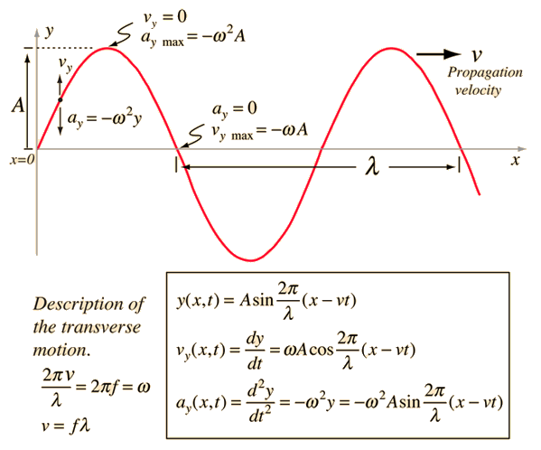
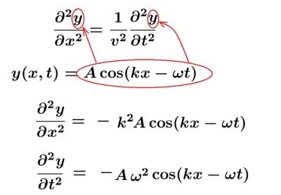
2D 2nd order differential equations
Wave equation

Slide 10
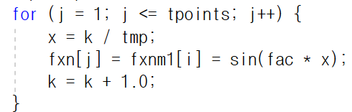
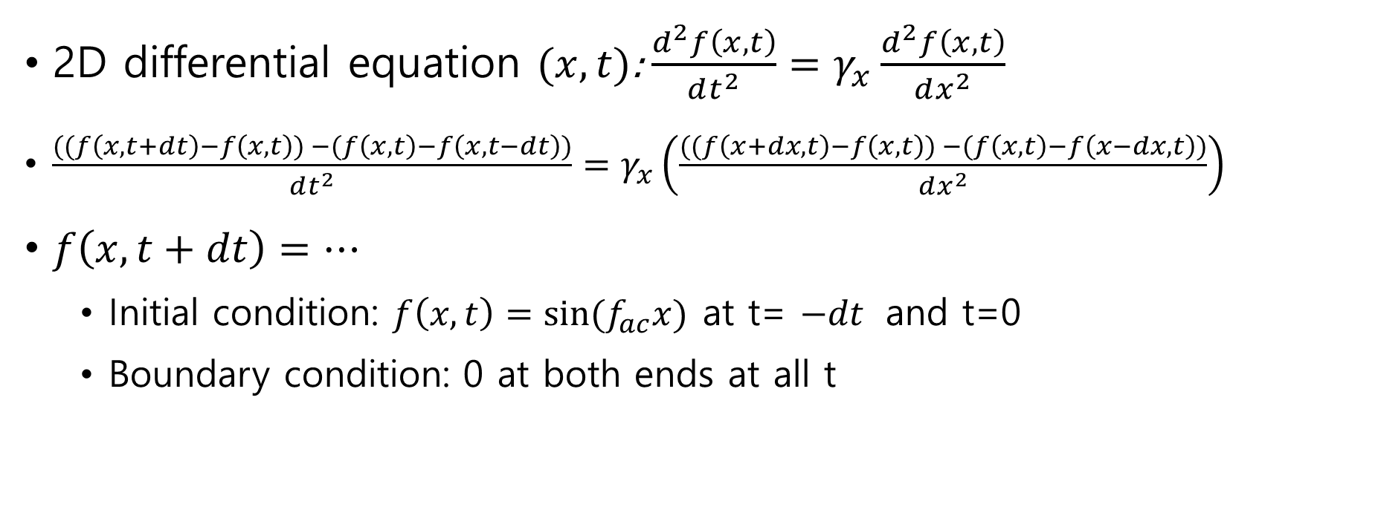
Wave equation “DEwave”
2D differential equation $(x, t)$: $\frac{d^{2}f\left(x,t\right)}{dt^{2}}=γ_{x}\frac{d^{2}f\left(x,t\right)}{dx^{2}}$
$\frac{((f\left(x,t+dt\right)−f\left(x,t\right)) −(f\left(x,t\right)−f\left(x,t−dt\right))}{dt^{2}}=γ_{x}\left(\frac{((f\left(x+dx,t\right)−f\left(x,t\right)) −(f\left(x,t\right)−f\left(x−dx,t\right))}{dx^{2}}\right)$
$f\left(x,t+dt\right)=…$
Initial condition: $f\left(x,t\right)=sin⁡(f_{ac}x)$ at t=$−dt$ and t=0
Boundary condition: 0 at both ends at all t

Slide 11

Heat transfer equation
$$∇^{2}T+\frac{\dot{q}}{k}=\frac{ρC_{p}}{k}\frac{∂T}{∂t}$$
Heat source

Slide 12
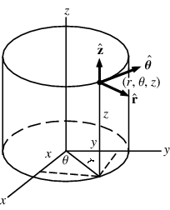
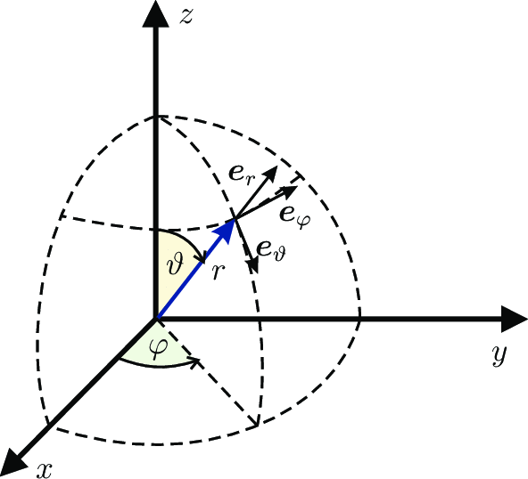
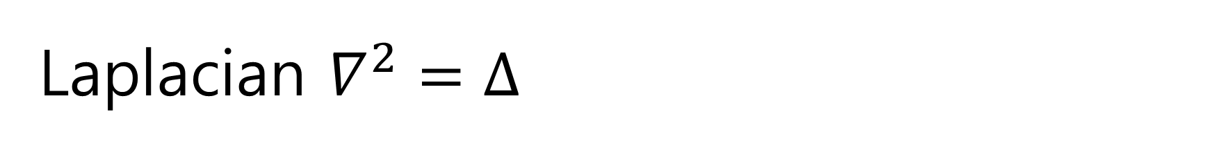
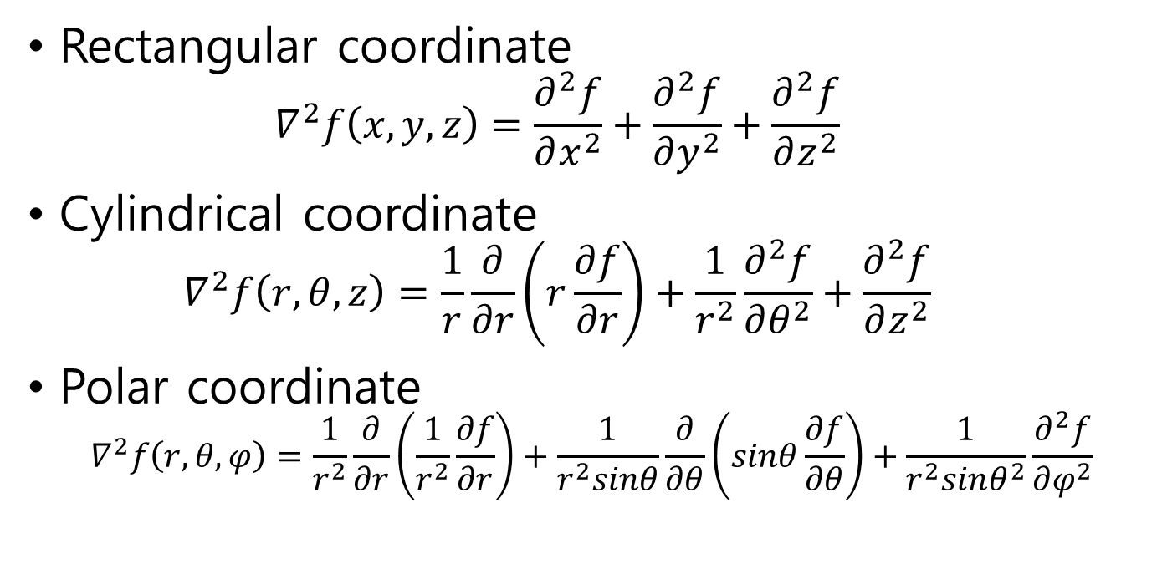
Laplacian $∇^{2}=∆$
Rectangular coordinate
$$∇^{2}f\left(x,y,z\right)=\frac{∂^{2}f}{∂x^{2}}+\frac{∂^{2}f}{∂y^{2}}+\frac{∂^{2}f}{∂z^{2}}$$
Cylindrical coordinate
$$∇^{2}f\left(r,θ,z\right)=\frac{1}{r}\frac{∂}{∂r}\left(r\frac{∂f}{∂r}\right)+\frac{1}{r^{2}}\frac{∂^{2}f}{∂θ^{2}}+\frac{∂^{2}f}{∂z^{2}}$$
Polar coordinate
$$∇^{2}f\left(r,θ,φ\right)=\frac{1}{r^{2}}\frac{∂}{∂r}\left(\frac{1}{r^{2}}\frac{∂f}{∂r}\right)+\frac{1}{r^{2}sinθ}\frac{∂}{∂θ}\left(sinθ\frac{∂f}{∂θ}\right)+\frac{1}{r^{2}sinθ^{2}}\frac{∂^{2}f}{∂φ^{2}}$$

Slide 13
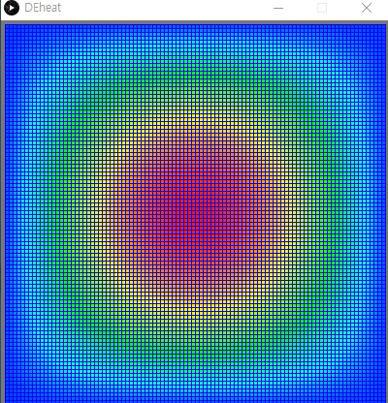

Ex) Heat equation
Boundary condition
0º at all sides
Initial condition
Hotter in the center
No heat source
$${\frac{∂T}{∂t}=φ}_{x}\frac{∂^{2}T}{∂x^{2}}+φ_{y}\frac{∂^{2}T}{∂y^{2}}$$

Slide 14
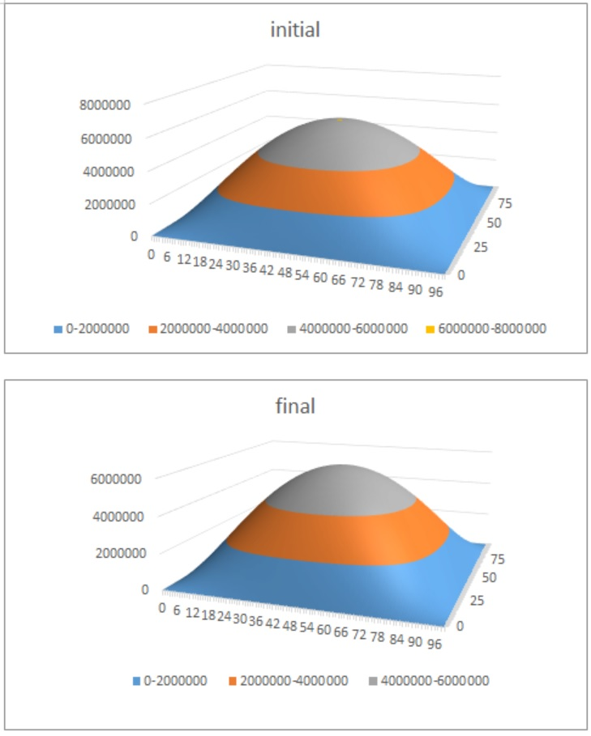
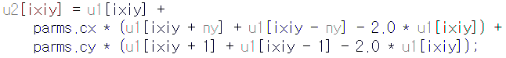
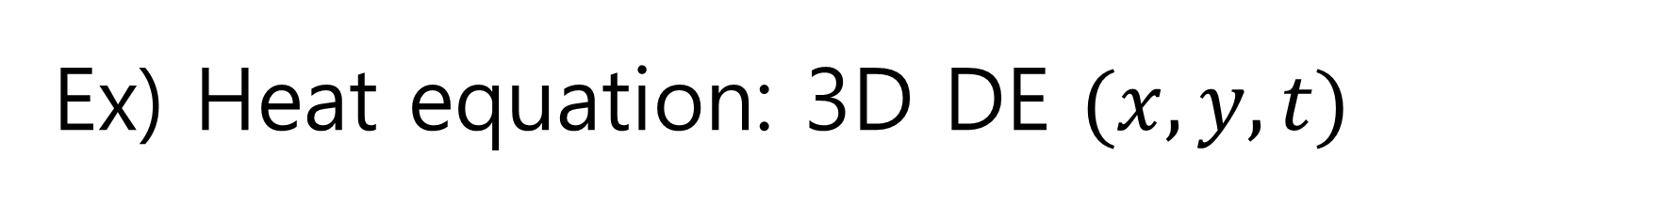
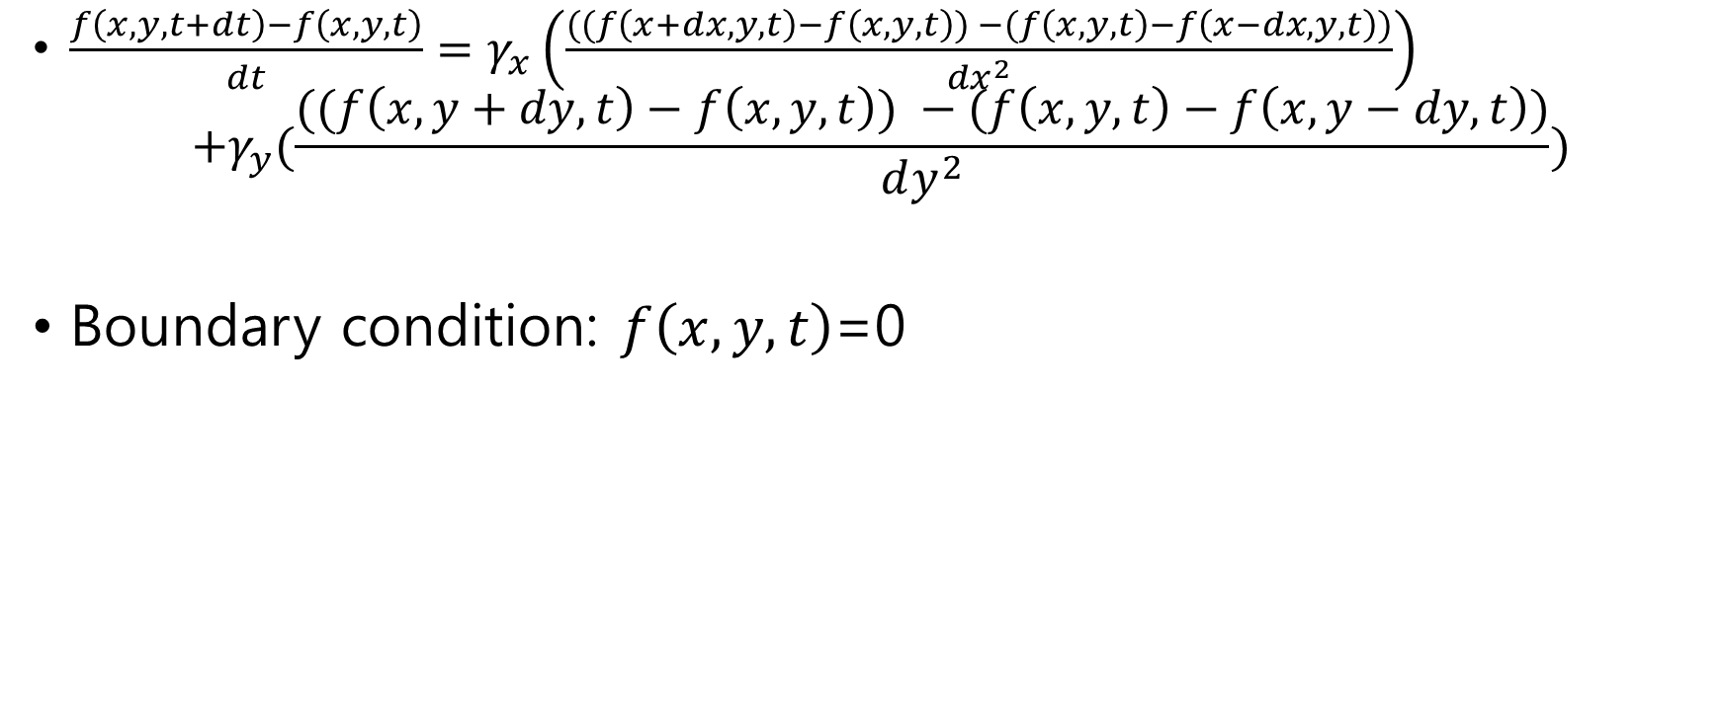
Ex) Heat equation: 3D DE $(x, y, t)$
$\frac{f\left(x,y,t+dt\right)−f\left(x,y,t\right)}{dt}=γ_{x}\left(\frac{((f\left(x+dx,y,t\right)−f\left(x,y,t\right)) −(f\left(x,y,t\right)−f\left(x−dx,y,t\right))}{dx^{2}}\right)$
$$+γ_{y}(\frac{((f\left(x,y+dy,t\right)−f\left(x,y,t\right)) −(f\left(x,y,t\right)−f\left(x,y−dy,t\right))}{dy^{2}})$$
Boundary condition: $f\left(x,y,t\right)$=0
conductivity

Slide 15
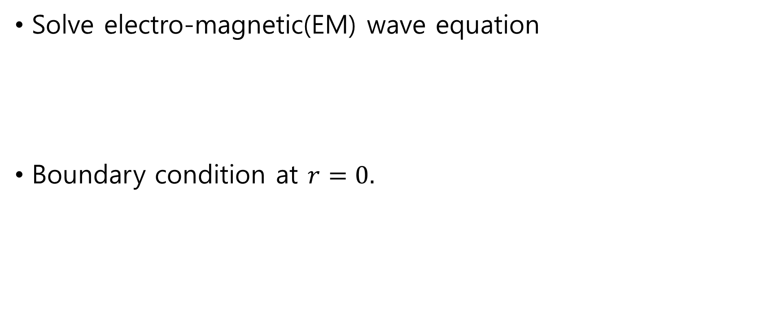
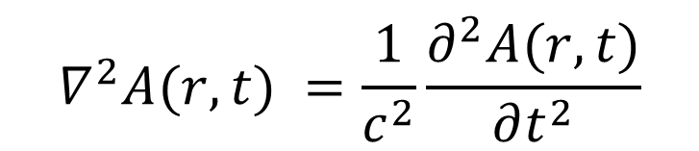
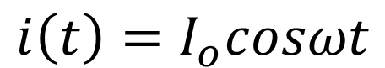
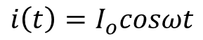
Assignment: EM wave antenna
$$i\left(t\right)=I_{o}cosωt$$
Solve electro-magnetic(EM) wave equation
Boundary condition at $r=0.$
$$∇^{2}A(r,t) =\frac{1}{c^{2}}\frac{∂^{2}A(r,t)}{∂t^{2}}$$
$$i\left(t\right)=I_{o}cosωt$$

Slide 16
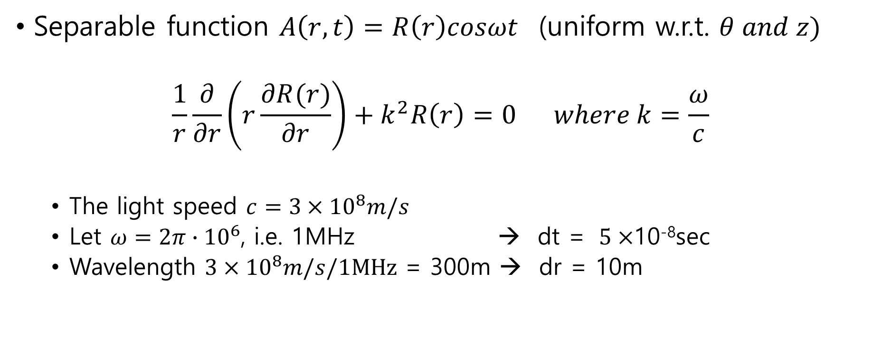
Separable function $A\left(r,t\right)=R\left(r\right)cosωt$ (uniform w.r.t. $θ and z)$
$$\frac{1}{r}\frac{∂}{∂r}\left(r\frac{∂R(r)}{∂r}\right)+k^{2}R\left(r\right)=0 where k=\frac{ω}{c}$$
The light speed $c=3×{10}^{8}m/s$
Let $ω=2π∙{10}^{6}$, i.e. 1MHz → dt = $5×$10⁻⁸sec
Wavelength $3×{10}^{8}m/s/1MHz$ = 300m → dr = 10m

Slide 17
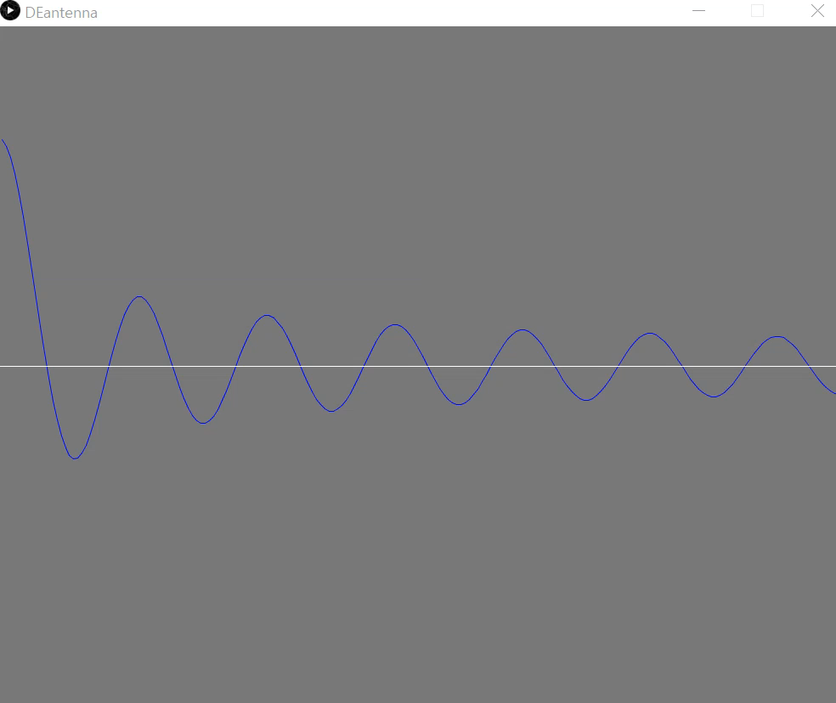

Slide 18
Taylor series For more accurate solution
2019. 3. 25
Doug Young Suh

Slide 19
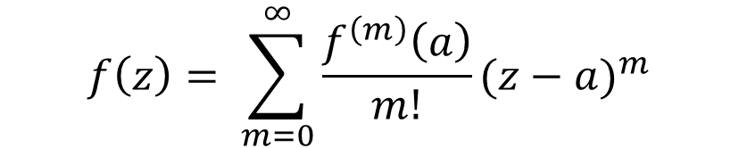
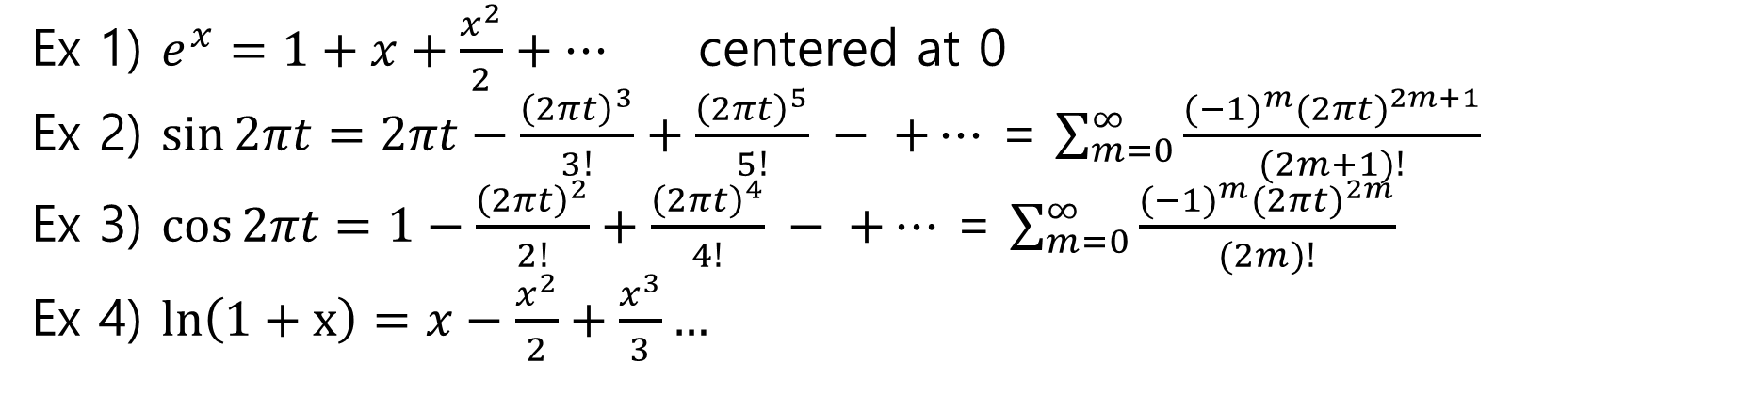
Taylor’s formula
$$f\left(z\right)= \sum_{m=0}^{∞}{\frac{f^{\left(m\right)}\left(a\right)}{m!}}(z−a)^{m}$$
centered at a
Ex 1) $e^{x}=1+x+\frac{x^{2}}{2}+…$ centered at 0
Ex 2) $\sin{2πt=2πt}−\frac{{\left(2πt\right)}^{3}}{3!}+\frac{{\left(2πt\right)}^{5}}{5!} − +…$ = $\sum_{m=0}^{∞}{\frac{{(−{1)}^{m}(2πt)}^{2m+1}}{(2m+1)!}}$
Ex 3) $\cos{2πt=1}−\frac{{\left(2πt\right)}^{2}}{2!}+\frac{{\left(2πt\right)}^{4}}{4!} − +…$ = $\sum_{m=0}^{∞}{\frac{{(−{1)}^{m}(2πt)}^{2m}}{(2m)!}}$
Ex 4) $ln\left(1+x\right)=x−\frac{x^{2}}{2}+\frac{x^{3}}{3}…$
Note 0! = 1.

Slide 20
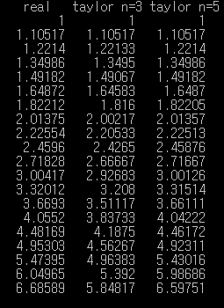
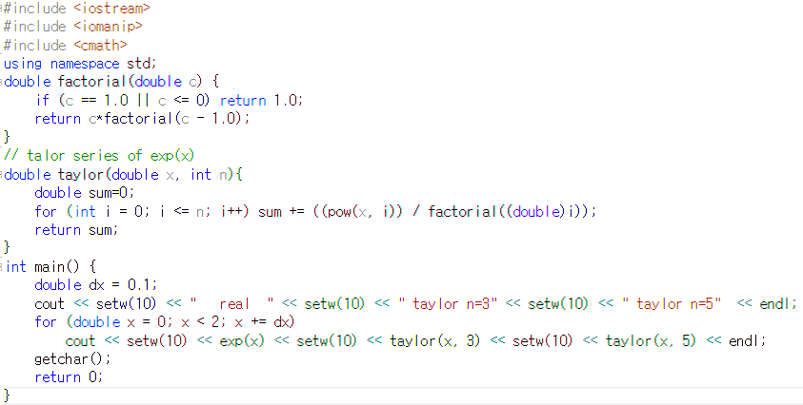
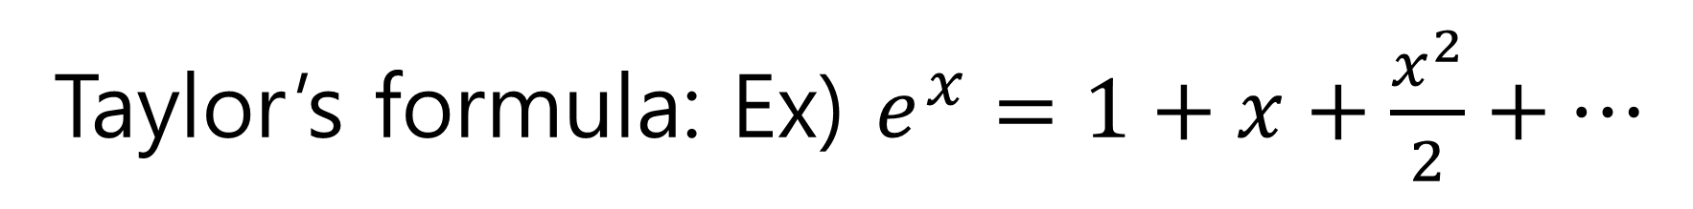
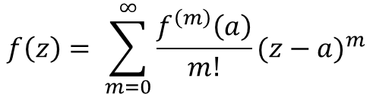
Taylor’s formula: Ex) $e^{x}=1+x+\frac{x^{2}}{2}+…$
G:\c-SWLab\FEM1D\2order\2order
$$f\left(z\right)= \sum_{m=0}^{∞}{\frac{f^{\left(m\right)}\left(a\right)}{m!}}(z−a)^{m}$$
centered at a

Slide 21
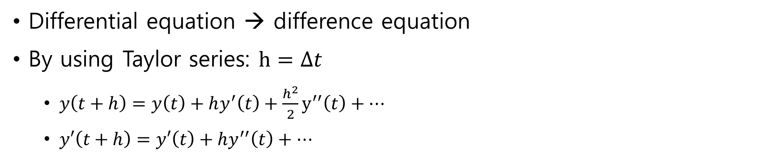
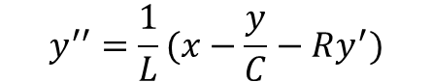
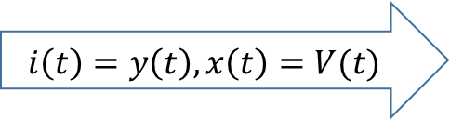
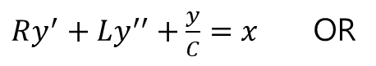
2nd Order Differential Equation
$Ry^{′}+Ly^{′′}+\frac{y}{C}=x$OR
$$i\left(t\right)=y\left(t\right), x\left(t\right)=V(t)$$
$$y^{′′}=\frac{1}{L}(x−\frac{y}{C}−Ry^{′})$$
Differential equation → difference equation
By using Taylor series: $h=∆t$
$y\left(t+h\right)=y\left(t\right)+hy^{′}\left(t\right)+\frac{h^{2}}{2}y^{′′}\left(t\right)+…$
$y′\left(t+h\right)=y′\left(t\right)+hy^{′′}\left(t\right)+…$

Slide 22
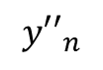
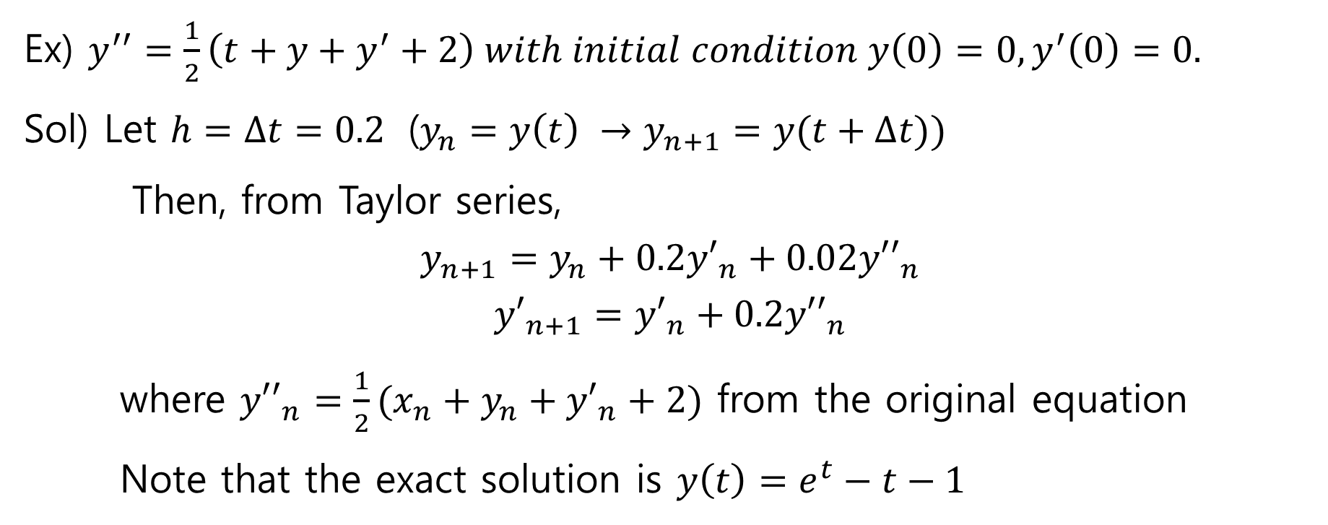
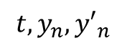
2nd DE: Example
Ex) $y^{′′}=\frac{1}{2}\left(t+y+y^{′}+2\right) with initial condition y\left(0\right)=0, y^{′}\left(0\right)=0.$
Sol) Let $h=∆t=0.2$ ($y_{n}=y\left(t\right) →y_{n+1}=y(t+∆t))$
Then, from Taylor series,
$$y_{n+1}=y_{n}+0.2{y′}_{n}+0.02{y′′}_{n}$$
$${y′}_{n+1}={y′}_{n}+0.2{y′′}_{n}$$
where ${y′′}_{n}=\frac{1}{2}(x_{n}+y_{n}+{y′}_{n}+2)$ from the original equation
Note that the exact solution is $y\left(t\right)=e^{t}−t−1$
$${y′′}_{n}$$
Update
y’’
Increase t
Update
y, y’
$${t,y_{n},y′}_{n}$$

Slide 23
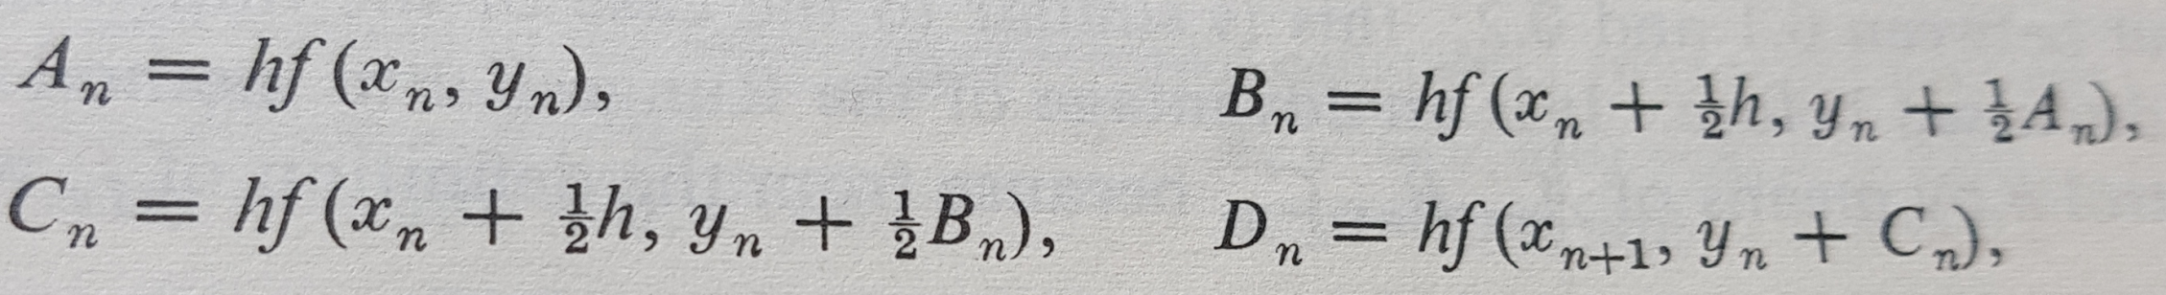
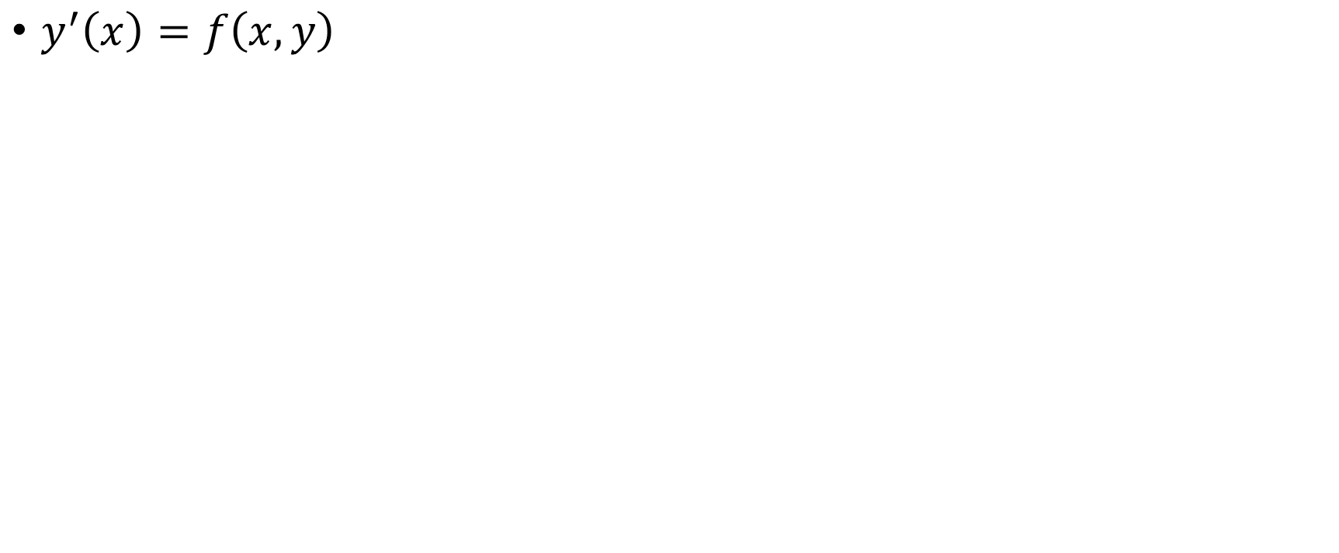
1st order Runge-Kutta
$y^{′}\left(x\right)=f\left(x,y\right)$

Slide 24
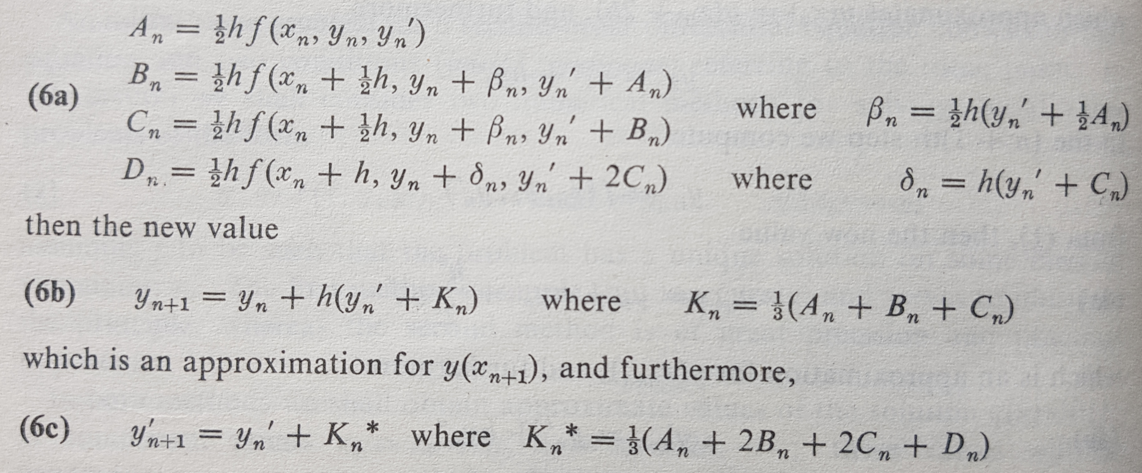
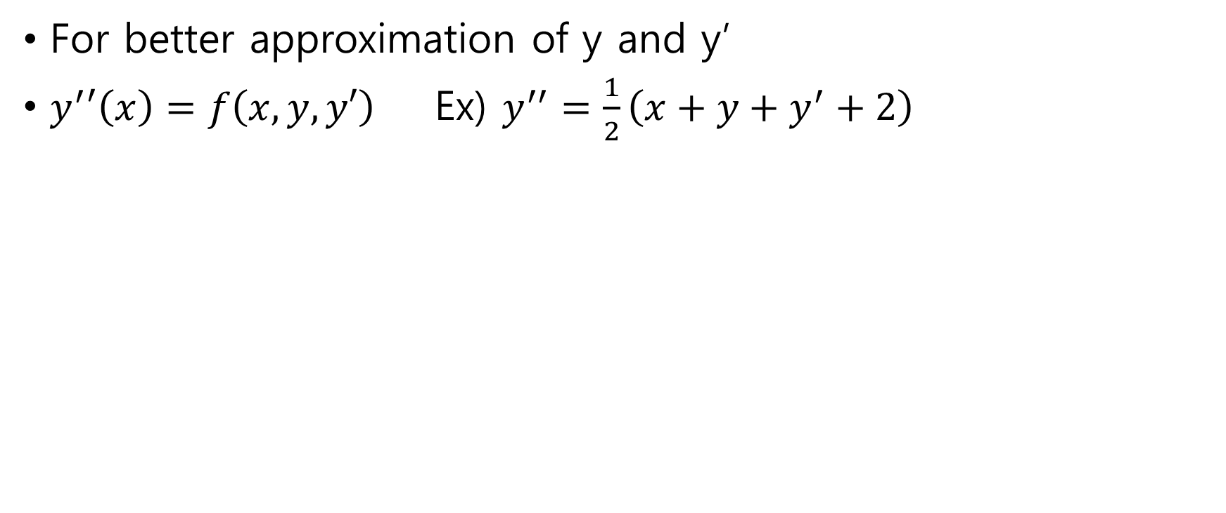
2nd order Runge-Kutta
For better approximation of y and y’
$y^{′}′\left(x\right)=f\left(x,y,y′\right)$Ex) $y^{′′}=\frac{1}{2}\left(x+y+y^{′}+2\right)$

